Slide 1
Antisemitism
White Nationalism
& Today

Slide 2
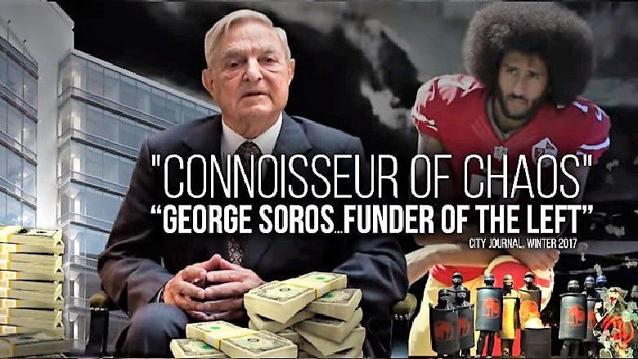
But first, a case study

Slide 3
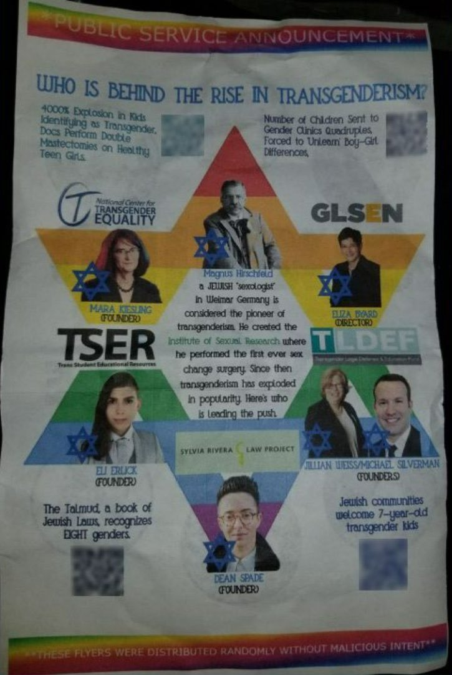
Another and more recent example

Slide 4
1
Historical Background
Well, how did we get here?

Slide 5
Social changes that got us here (the ‘modern’ world)
(these have happened globally from 1400’s onwards and repeat in microcosms)
Enclosures
Removal of people from communal lands,
Mass privatization puts these assets in control of a much smaller segment of population (ex: nobiles or industrialists)
Removed peoples now have to sell their labor to obtain base necessities they used to have
Imperialism
Political & economic relationship in which the people and government of a country are trapped in restrictive and extractive debt relationships with imperial core countries.
Note: does not require physical occupation of a territory by an imperial power.
Colonization
Replacement and displacement of indigenous communities with population from ‘home countries’
Marked by genocides and enslavement, resources taken from the colonies to enrich the imperial core
It’s important to think about how these changes impacted cultures & societies!
History is NOT just dates &
old dead dudes!!

Slide 6
Oppressions are similar
(except where each one is unique.)
Different oppressions have different defining characteristics.
Euro-Oppression of indigenous people in the Americas: Erasure
Euro-Oppression of Africans: Exploitation
Euro-Oppression of Jews: Scapegoating

Slide 7
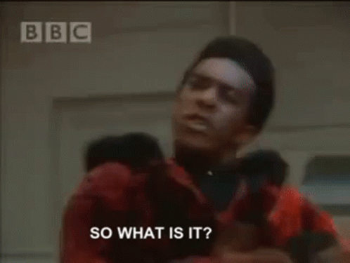
Christian Hegemony
The predominance of Christian values, belief systems, and cultural norms throughout all aspects of society, including the educational, political, social, economic, and legal systems

Slide 8
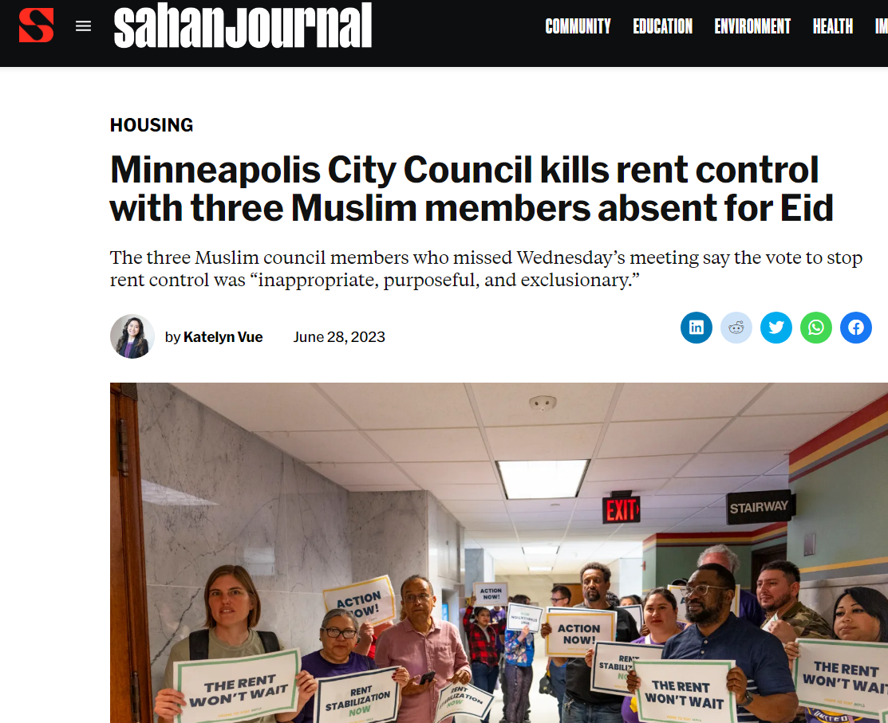
A local example!
Intentionality is not needed for this to be an example of Christian hegemony!

Slide 9
What is whiteness? What is nationalism??
Whiteness- a concept that began as a social designation in the colonial Americas, then became enforced by law internationally by Europeans, by the 18th/19th century it became legitimized into the fields of science & biology, as it expanded to include Europeans of more backgrounds it evolved into an artificial cultural identity.
Nationalism- concept that holds that a nation (i.e. a group of people) can only truly be represented via a formal state (i.e. the government). It further aims to build and maintain a single national identity, based on shared social characteristics of culture, ethnicity, geographic location, language, politics (or the government), religion, traditions and belief in a shared singular history, and to promote national unity.

Slide 10
How is this relevant to today’s presentation?
The forms of oppression we see today are culturally ingrained and have been formed and reinforced by these economic relationships.
Antisemitism & racialization are direct results of these economic shifts
In the 21st century we are interconnected as a global society, we need to understand that large cultural notions like racialization cannot be viewed in isolation in time and space
These huge changes in human society have created a near universal feeling of detachment, called social malaise, an important aspect of the spread of racism, misogyny, antisemitism, and other forms of hate.

Slide 11
Social Malaise
A constant within modern society- its the compounded emotional effects of the sudden changes humans (individually & socially) have endured the last few hundred years.
Fascists recognize & agitate this common feeling & redirect it to animate violence against their social & political enemies

Slide 12
2
Antisemitism as a structure
It’s more than just slurs or a personal hatred

Slide 13
Antisemitism
System of ideas, based on white supremacy and European Christian hegemony, passed down through a society’s institutions to enable the scapegoating of Jews, and the ideological or physical targeting of Jews that results from that.

Slide 14
How does this machine work?
Antisemitism is a set of stories & myths, largely created to protect people in power by shifting blame for society’s problems to Jews, especially during moments of change or social unrest.

Slide 15
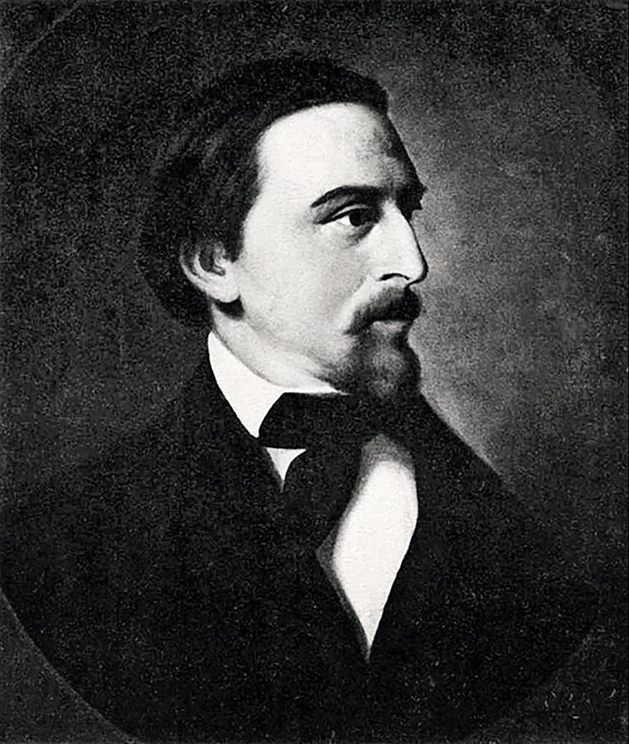
Ok, but what the heck is a ‘Semitism’?
The term “antisemitism” was coined in 1879 by German nationalist Wilhelm Marr, who wanted to give his ideology - previously called “Judenhass,” (literally Jew-hate) more credibility.
He proposed the idea of “Semitism,” borrowing the word from the budding world of linguistics, to imagine a worldwide Jewish (Semitic) conspiracy that Jews were inherently inclined to undo European (Christian) society, and his response was the ‘logical’ and scientific-sounding antisemitism.
Portrait of racist dweeb, Wilhelm Marr

Slide 16
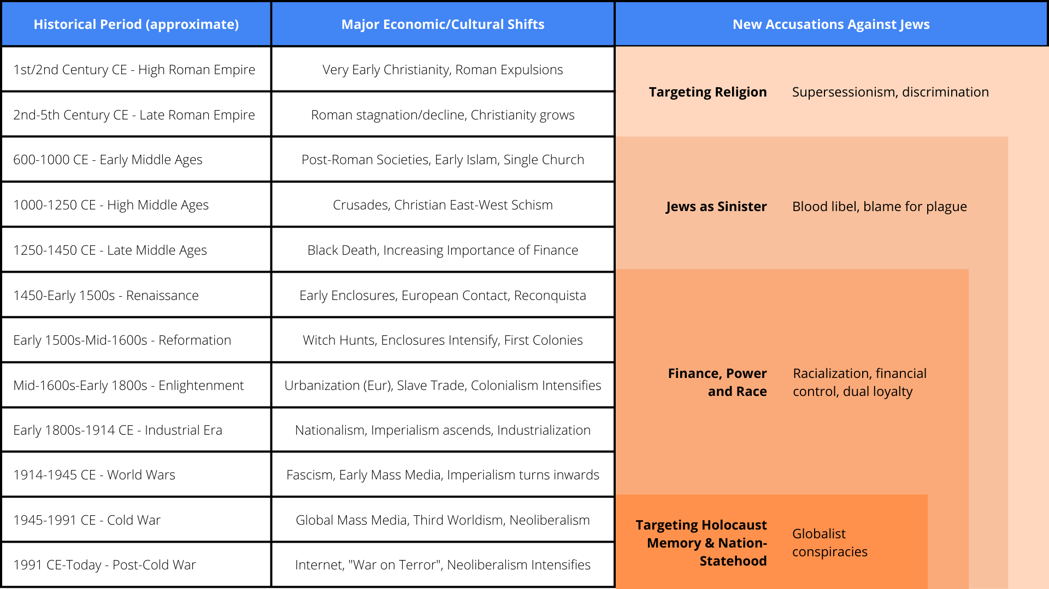
Antisemitism has changed over time
 | Week 1 |  |  |  |  |  |  | Week 2
 | 1 | 2 | 3 | 4 | 5 | 6 | 7 | 8 | 9 | 10 | 11 | 12 | 13 | 14
Task 1
Task 2 |  |  |  |  |  | ◆
Task 3
Task 4 |  |  |  |  |  |  |  |  |  |  | ◆
Task 5 |  |  |  |  |  |  |  |  | ◆
Task 6
Task 7
Task 8

Slide 17
This is Both Ancient and Extremely Modern
Jews have been put in this buffer/scapegoat role physically and rhetorically.
Early Modern Period (1400-1600s)
Italian City States
Eastern Europe
The Protocols of the Elders of Zion
Red Scares 1 & 2
Stereotypes/Common Tropes

Slide 18
Antisemitism is a synthesis of Historical and Structural Scapegoating
It’s more than a series of individual acts of hatred, it’s a set of lies that white supremacy tells us. And it’s for a reason.
It has changed drastically from its origins in Christian persecution
As the world became simultaneously more interconnected and unequal, the power of antisemitic narratives have grown
Capitalism needs racism in order to dehumanize Black and brown people to exploit for free and cheap labor. It needs antisemitism in order to create a scapegoat and obscure capitalism itself (more on this in a bit).

Slide 19
How has it (generally) worked?
Power structure isolates Jews, especially from other minority/exploited/oppressed groups.
Power structure teaches other oppressed groups out of identifying the sources of their exploitation, encouraging them to channel anger at Jews instead.
Jews are targeted for violence or other danger.
In hopes of gaining safety, Jews cooperate with ruling elites, creating pressure to silence themselves and not rise up against the powerful, for protection against greater targeting.

Slide 20
What does antisemitism look like?
It functions differently than other types of oppression, which makes it hard to recognize. It appears to punch up.
One of the main pillars of antisemitism is to keep the Jewish face in front of power, so that Jews become the target of people’s rage.
Like a turning gear, it’s cyclical and is generally strongest when Jews are otherwise assimilated and doing well (that’s a feature, not a bug).
So we have to have some power and influence to make the stories seem true.
Some antisemitic tropes seem like compliments - but they are still lies that white supremacy tell us and they should be interrogated.

Slide 21
What it does:
How it does it:
What it actually is:
Keeps wheels of economic oppression hidden from view.
It is meant to obscure class, caste & racial oppression
Claims that Jews are the “man behind the curtain,”
controlling the levers of power
But antisemitism IS the curtain.

Slide 22
Why do we need to understand this now?
Antisemitism works in relationship with racism and xenophobia to divert people away from the systems oppressing them. We can’t change those systems if we buy into the diversion.
Our movements need to learn about & be able to identify the underlying power structure to dismantle racialized capitalism and massive power inequality - and not believing it’s “the Jews.”
The political moment is loaded with conspiracy theories and a lot of them have direct roots in antisemitism.
It’s so important to understand this in order to unpack and undermine them when we see and hear them.

Slide 23
3
White Nationalism
American as Apple Pie,
Now a Global Export

Slide 24
What’s the difference?
White Supremacy:
Belief that white people are superior to other people.
Also applies to systems that were founded on these beliefs [or by those with these beliefs] and continue to enforce these artificial societal ‘norms’
White Nationalism:
Belief in a ‘white identity’ and a need/desire for a nation-state exclusively for white people.
White Nationalism is inherently a white supremacist ideology

Slide 25
White Nationalist Ideology
Whites* are a biologically defined people.
Black people and other People of Color are biologically inferior. Therefore, their achievements present a logical and existential problem.
Jews are a race – a demonic, conspiratorial race.
Whatever success People of Color have in America, Jews are behind it: Jews form a cabal that uses People of Color as pawns to destroy white nationhood.

Slide 26
An extremely short history of white nationalism
The Lost Cause- Reconstruction loosely enforced, ex-Confederates are not punished and instead wage a war of terror & realize history is written by those who hold the pen.
The First Red Scare- in the first few years after the Russian Revolution, an anti-communist paranoia sweeps the nation largely targeting Black & immigrant communities which are viewed as ‘hotbeds’ of Bolshevism.
The Roaring 20s- The Klan resurges (nearly 4 million members), Henry Ford distributes antisemitic screeds
The Great Depression- While the ‘Business plot’ fails to overthrow FDR, and mass ‘Popular Front’ politics ( multi-racial, multi-faith coalition of socialists, communists, sharecroppers, trade unionists and more) pushes back against fascist movements in the US

Slide 27
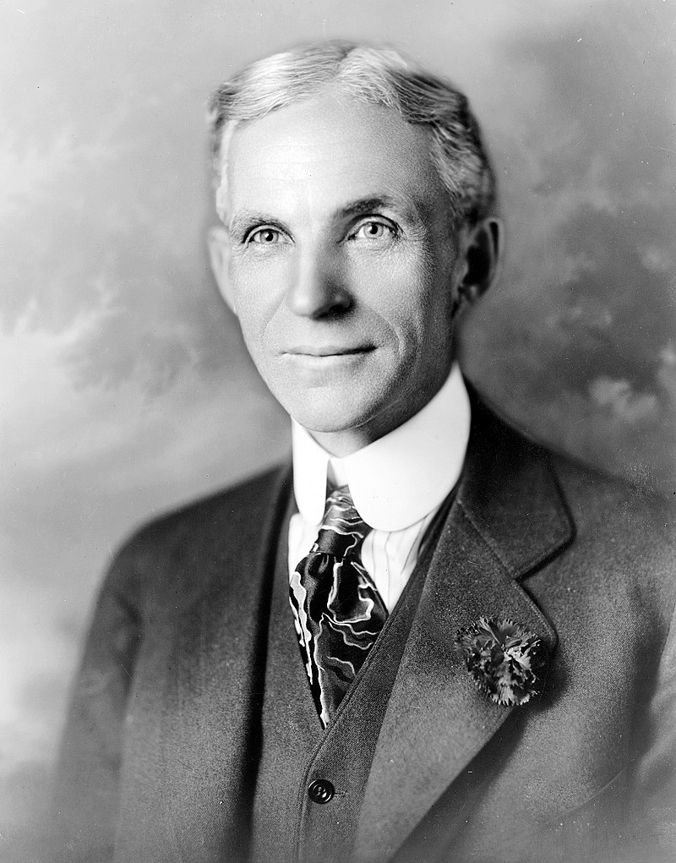
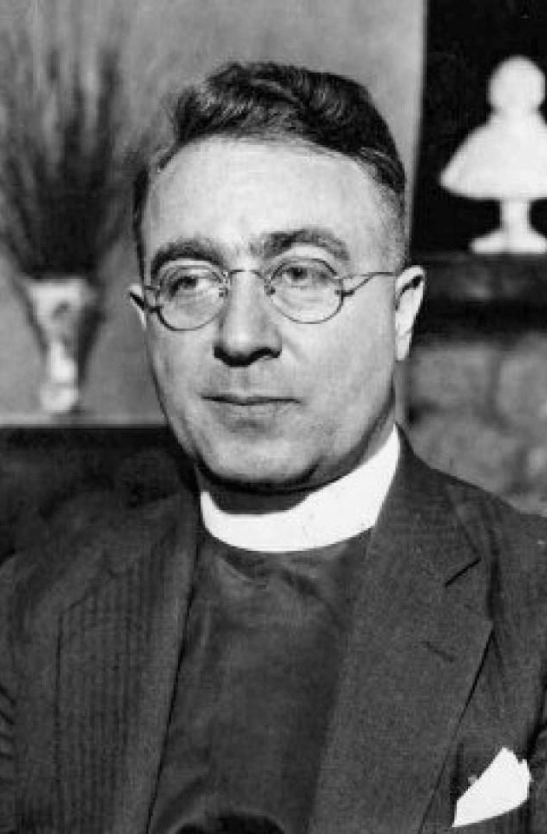
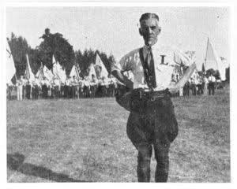
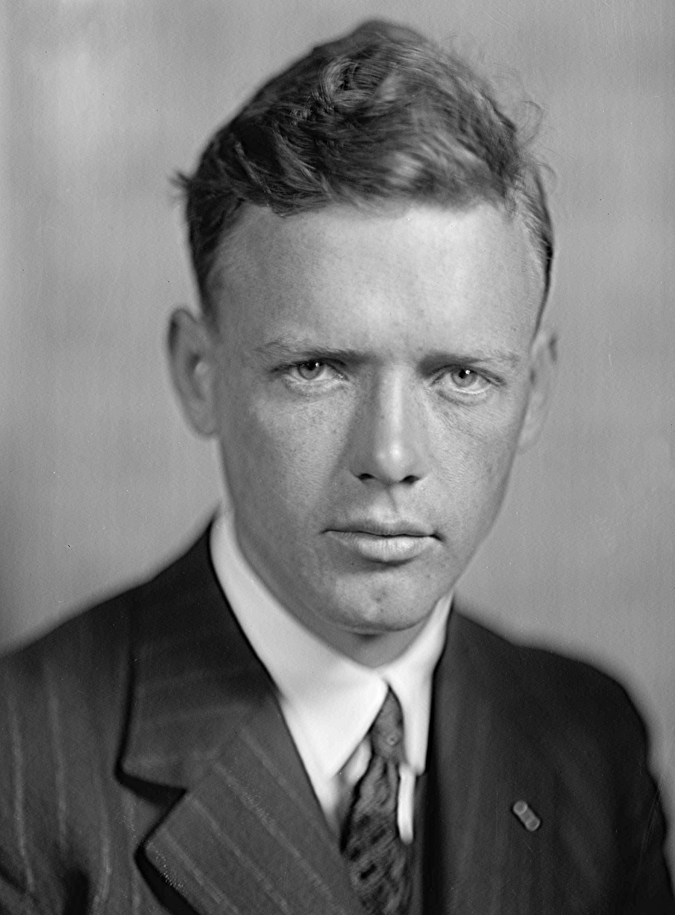
Prophets of Deceit
Some characters & groups from the last high-water mark of American fascism
Henry Ford
Ford was a rabid antisemite & racist figure. Through his company-town newspaper the Dearborn independent and his Ford dealerships, he managed to distribute the Tsarist “Elder Protocols” to a new audience, gaining the attention & adoration of Nazi Germany
Father Coughlin
Coughlin was the first of the shock-jock radio hosts, his radio show had millions of listeners. He used his immense platform to spread conspiracy theories much like the televangelists of the 1970s and the far-right personalities of today.
The Silver Legion
The Silver Legion, or Silver Shirts, were the largest fascist group in the United States in the 1930s, with Minnesota playing a central role in their organization.
Silver shirts, like the Brown & Black shirts of Europe, would attack people on the streets and had numerous allies in government.
Charles Lindbergh
Lindbergh, while mostly remembered in the Us for his transatlantic flight or the kidnapping of his young child, was likewise a prominent fascist figure. Like Ford his activism in the America First movement gained the admiration of Europe’s fascists.

Slide 28
An extremely short history of white nationalism
Civil Rights (50s-60s)- Direct groups like Klan begin to be prosecuted, largely piecemeal during this decade long process of gradual enforcement of the 14th Amendment & Reconstruction-era anti-Klan laws.
Post-Civil Rights (70s onward)- Mass resistance to desegregation finds new allies in new places (For example, the Klan opens up to Catholics) Professional coalitions of lawyers & businessmen invest in a long culture & legal war to roll back civil rights (of all sorts)
Post-9/11- following the September 11th attacks, Islamophobia hits a fever pitch and a narrative of a ‘clash of cultures’ or modern Crusades becomes immensely popular in many US cultural spaces. Growth of ‘Great replacement’ myth following the 2010 census & election of Barack Obama.

Slide 29
The Great Replacement
Once upon a time was niche, coming from 80s neo-nazi phrase ‘14 words’
It’s a fantasy that ‘white identity’ is being erased through a ‘great replacement’ of people from other backgrounds and cultures.

Slide 30
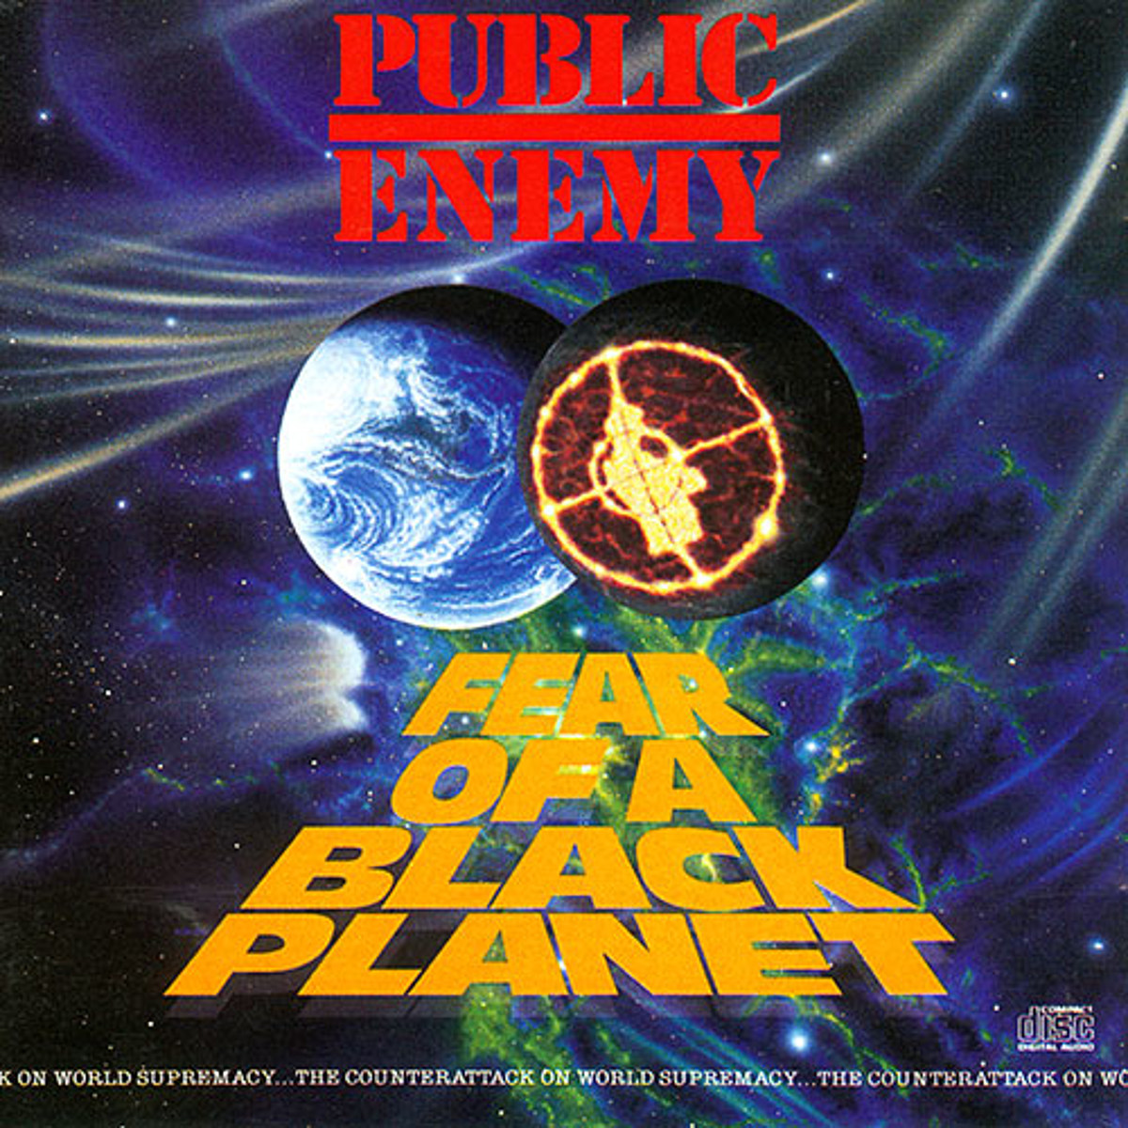
Why is the Great Replacement a unifying element for these groups?
Its a story that takes that social malaise and redirects it with the extremely familiar catalogue of racist ideas present in America & white European culture.
Central to the fantasy is that Jews are orchestrating politics that will result in white people being ‘outpopulated’

Slide 31
“Like other white nationalists, however, the Buffalo shooter must resolve a contradiction. If Black and brown people are inferior, how have they managed to invade and nearly conquer the Western world?
Here’s where Jews come in. Since Jews are malevolent in a different way—morally degenerate but supremely cunning—they control and manipulate the invaders from the Global South. In one montage, the shooter identifies the “Jews behind the NAACP”—because, of course, Black Americans could not possibly run their own civil rights organization.
And Jews don’t only control other racial and ethnic groups. We’re behind the movement for transgender rights, too.”
–Why White Nationalism Requires Antisemitism, Peter Beinart, 2022

Slide 32
4
Radicalization Today
Big tech + Mass media = Faster than ever before

Slide 33
The Algorithm
Social media and other content services are competing for our attention,
we are both the product and the resource.
Algorithms are meant deliver content based off of interactions and views, they are highly addictive as well in their delivery to users

Slide 34
How the social media ‘pipeline’ to violence happens
Addictive
Like casinos, algorithms are built to keep you there as long as possible
Easily ‘gamed’ algorithms send users down rabbit holes of increasingly extreme content and remove anti-racist content
Constant Exposure
users are lead to other websites, forums, etc where users find ‘community’

Slide 35
Internet Culture
GamerGate
Began as a harassment campaign against a female game dev
Became digital war against anyone who threatened a certain view of “gamer” [young, white, male]
Incels
Online community of men who feel they are deprived of sexual contact, believe they have a right to women’s bodies
Grew quickly after 2014 sorority massacre

Slide 36
EVERY
THING
IS
GAMER
GATE
GamerGate was in many ways an inflection point for the social-media age: It showed trolls that they could use tactics old and new to abuse targets en masse in pursuit of reactionary, antifeminist politics. As racist ideology became more mainstream in the era of Donald Trump, many of the men involved in GamerGate became part of campaigns that utilized the same tactics to push racism, anti-immigrant sentiment, and white-nationalist rhetoric.
A campaign that began as revenge against an allegedly cheating girlfriend morphed into a retrograde wave that encompassed racial minorities, women, and progressive ideology more generally. The young men energized by reactionary politics, radicalized by participation in harassment campaigns, and ready and able to engage in nimble, hard-to-foil propaganda operations were ripe for recruitment by America’s organized racist movements.
-Talia Lavin, Culture Warlords, p. 92

Slide 37
Social media accounts to follow:
Instagram:
@jca_mn
@jfrejnyc
@jewishcurrentsmag
@jcua_chicago
@jewitches
@zinneducationproject
Tik Tok:
@interstellar_isabellar
@simkern
@ravenreveals
@zarazahavah
@evelkneidel
@gaygtownbae
Twitter:
@BenLorber8
@PRAEyesRight
@shane_burley1
@swordsjew
@rafaelshimunov
@ArnoRosenfeld
Final Questions?
You can contact me at:
brandon@jewishcommunityaction.org

